Slide 1

Introduction to Onix Renewable
Leading company in clean energy
Innovative solutions for sustainability

Slide 2

Overview of MoU Signing
Partnership with Gujarat Government
Focus on clean energy expansion

Slide 3
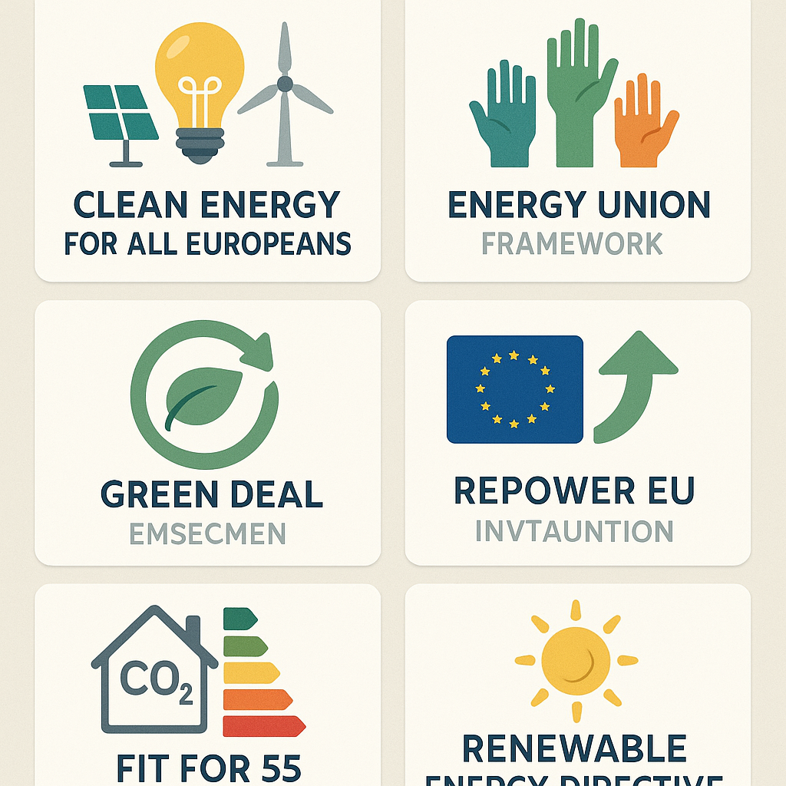
Vibrant Gujarat 2026 Event
Prominent business summit
Gathering of global leaders

Slide 4

Goals of Clean Energy Expansion
Increase renewable energy capacity
Enhance environmental sustainability

Slide 5

Benefits for Gujarat
Economic growth opportunities
Job creation in the energy sector

Slide 6

Future Outlook
Long-term partnership potential
Commitment to sustainable development

